Slide 1



192.168.59.0 / 24
Mgmt Server
192.168.59.134
eth0
192.168.59.135
eth1
192.168.1.254
eth2
192.168.2.254
DMZ Server
192.168.1.1
Internal Server
192.168.2.1
Firewall-1
192.168.1.0 / 24
192.168.2.0 / 24

Slide 2
1) Only the Mgmt Server and Internal Server are allowed to SSH into Firewall-1.
2) The Mgmt Server can ping to Internal Server and its network, DMZ Server and its network, and Firewall-1.
3) The Internal Server can relay emails via the SMTP service in DMZ Server.
4) The Mgmt Server can resolve hostnames with Internal Server. The Internal Server can forward unresolve DNS queries to the DMZ Server.
5) All networks and Firewall-1 can synchronise their computer time with Internal Server.
6) The DMZ Server cannot talk to computers in both Mgmt and Internal networks.
7) All computers in Internal Server’s network can ftp into the DMZ Server.
8) The Mgmt Server and DMZ Server can resolve names using the Internal Server.

Slide 3
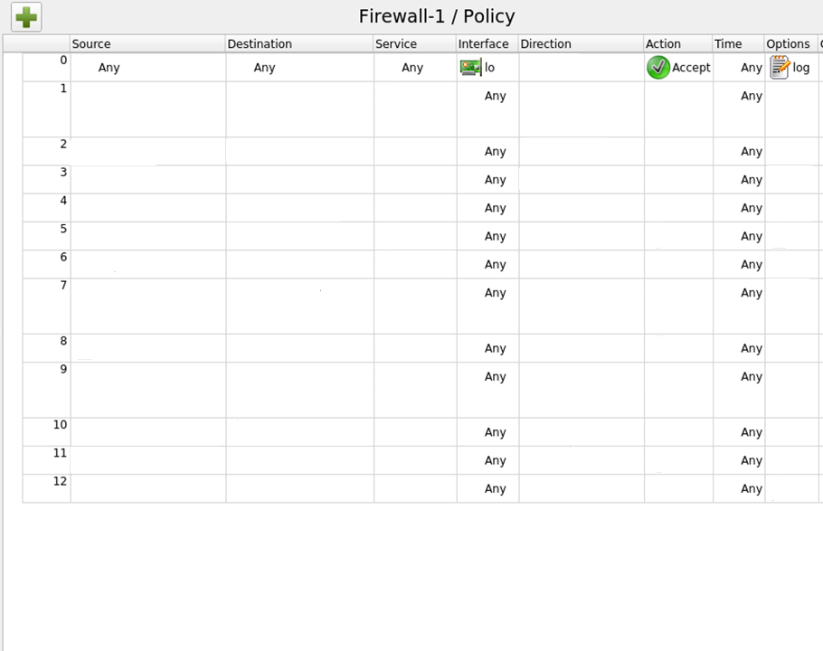



DMZ Server
DMZ Server
DMZ Server
DMZ Server
DMZ Server
ftp
DMZ Server

